Slide 1
MELINA MERKOURI
Α PROJECT BY XARITOMENI E2

Slide 2
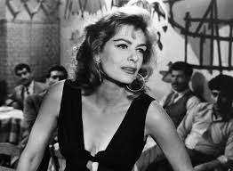
BIOGRAPHY
Maria Amalia Mercouri (18 October 1920 – 6 March 1994), known professionally as Melina Mercouri ,was a Greek actress, singer and politician.

Slide 3
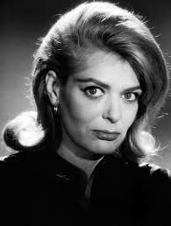
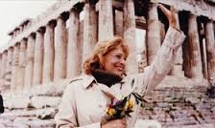
FILMOGRAPHY
Merκouri's first movie was the Greek language film Stella (1955), directed βυ the Greek director Michael KaKoyannis. The film received special praise at the 1956 Cannes Film Festival, where she met American film director Jules Dassin, with whom she would share not only her career but also her life.

Slide 4
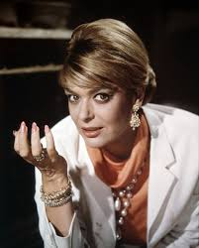
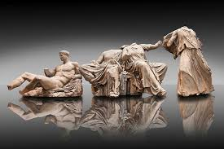
THE RETURN OF THE GREEK MARBLES
Melina's greatest dream as a politician was the return of the marbles of the Parthenon, known as the Elgin marbles, back in Greece. Now they are in the British Museum.

Slide 5
FAMOUS QUOTES
"You must understand what the Parthenon Marbles mean to us,“
she said."It is our pride.
They are our sacrifices. It is the supreme symbol of courtesy. It is
a tribute to democratic philosophy
. It is our ambition and name. It is the essence of our
Greekness "

Slide 6
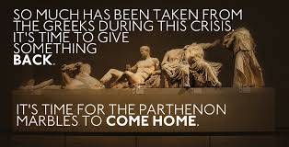
THE IMPORTANCE OF THE MARBLES
"I'm hoping to see the Marbles Back to Athens Before I Die. But if they come later, I will be born again ... ". This phrase belongs to Melina Merkouri, who has made her life in the life of the Parthenon Sculptures from the British Museum in Greece. Melina Merkouri laid the foundations for the restoration of the Parthenon sculptures in Greece. She was the one who "forbade us" to call them "Elginia". And he was right. Because Elgin's never been.

Slide 7
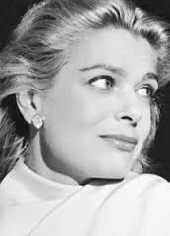
The end of the ‘‘battle’’
FINALLY MELINA MERKOURI ON 6 MARCH 1994 WITHOUT BEING SATISFIED TO see THE PARTHENON MARBLEs IN GREECE

Slide 8
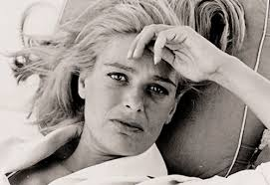
THE END

