Slide 1
ODYSSEAS ELYTES
ODYSSEAS ELYTES
SOFIA

Slide 3
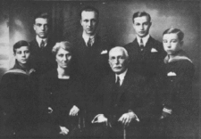
HISTORY
Odysseus Elυtes was born in Heraclius on island of Crete, 2 November 1911.His family later moved to Athens, where he graduated from high school.

Slide 4
In 1953 Elites wrote his first poem in the journal, NEW LETTERS with his friend George Severus.

Slide 5
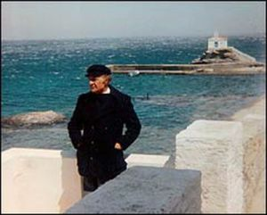
TRAVELS
Between 1948 and 1972 he lived in Paris and he worked with artists and philosophers. He started from Paris then moved to Switzerland, England, Italy and Spain.

Slide 6
POEMS
Sun The First Together With Variations on A Sunbeam 1943
An Heroic And Funeral Chant For The Lieutenant Lost In Albania 1946
To Axion Esti—It Is Worthy 1959

Slide 7
THE END
Odysseus Elites had been completing his plans to travel overseas, when he died in Athens on 18 March at the age 84.He was an important and popular poet.

